Slide 1
Operating Systems
Chapter 4
Threads
Hammad Afzal
hammad.afzal@mcs.edu.pk
Department of Computer Software Engineering
National University of Sciences and Technology

Slide 2
Roadmap
Overview
Multithreading Models
Thread Libraries
Threading Issues
Operating System Examples
Windows XP Threads
Linux Threads

Slide 3
Objectives
To introduce the notion of a thread — a fundamental unit of CPU utilization that forms the basis of multithreaded computer systems
To discuss the APIs for the Pthreads, Win32, and Java thread libraries
To examine issues related to multithreaded programming

Slide 4
Processes and Threads
Processes have two characteristics:
Resource ownership - process includes a virtual address space to hold the process image
Scheduling/execution - follows an execution path that may be interleaved with other processes
These two characteristics are treated independently by the operating system
The unit of dispatching is referred to as a thread or lightweight process
The unit of resource ownership is referred to as a process or task

Slide 5
Overview
Basic unit of CPU utilization
Comprises a Thread ID, Program Counter, Register Set and a Stack.
It shares its code section, data section, and other OS resources such as open files.

Slide 6
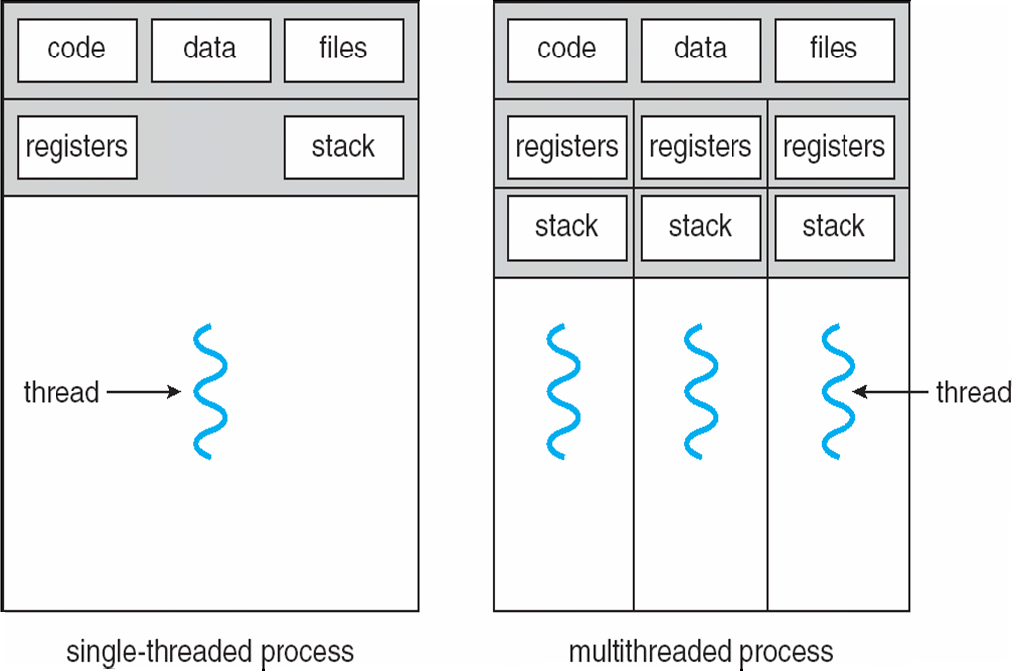
Single and Multithreaded Processes

Slide 7
One or More Threads in Process
Each thread has
An execution state (running, ready, etc.)
Saved thread context when not running
An execution stack
Some per-thread static storage for local variables
Access to the memory and resources of its process (all threads of a process share this)
Notes:
Within a process, there may be one or more threads, each with the following:
• A thread execution state (Running, Ready, etc.).
• A saved thread context when not running;
one way to view a thread is as an independent program counter operating within a process.

Slide 8
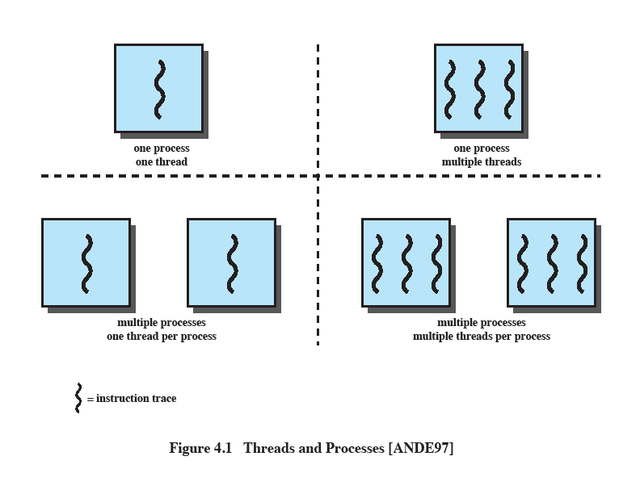
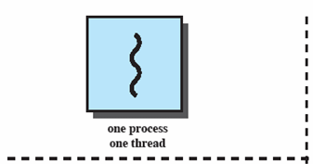
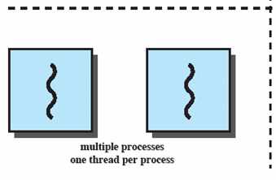
Single Thread Approaches
MS-DOS supports a single user process and a single thread.
Some UNIX, support multiple user processes but only support one thread per process
Notes:
Animated Slide
Onload Enlarges top-left to discuss DOS
Click1: Enlarges bottom-left for Unix
Single Threaded approach: The traditional approach of a single thread of execution per process, in which the concept of a thread is not recognized, examples are
MS DOS (single process, single thread)
Unix (multiple, single threaded processes)

Slide 9
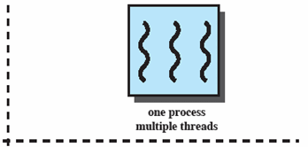
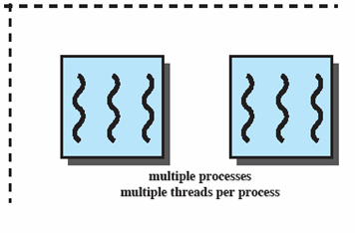
Multithreading
Java run-time environment is a single process with multiple threads
Multiple processes and threads are found in Windows, Solaris, and many modern versions of UNIX
Notes:
Animated Slide
Onload: Emphasis on top-right and JRE (single process, multiple thread),
Click 1: Emphasis on multiple processes with multiple threads – this is the main topic of this chapter
JRE is an example of a system of one process with multiple threads.
Of main interest in this chapter is the use of multiple processes, each of which support multiple threads.
Examples include:
Windows,
Solaris,
and many modern versions of UNIX.

Slide 10
Motivation
Application implemented as a separate process with several threads of control.
Multiple tasks with the application can be implemented by separate threads.
For example, in browser, various tasks performed in threads include
Update display
Fetch data
Receive input from user.

Slide 11
Motivation
Process creation is heavy-weight while thread creation is light-weight.
Generally more efficient to use one process with multiple threads.
Can simplify code, increase efficiency
Kernels are generally multithreaded.
Each thread performs a specific task such as managing devices or interrupt handling.

Slide 12
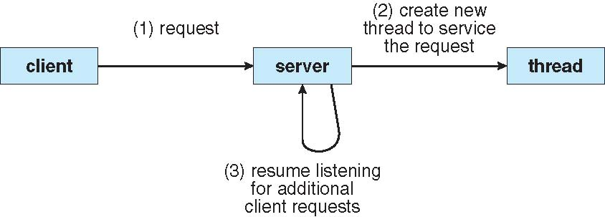
Multithreaded Server Architecture

Slide 13
Benefits
Responsiveness:
Interactive application remains responsive even when part of it is blocked or busy in a lengthy operations
Resource Sharing
Threads share the memory and resources of processes by default.
Shared code and data: several different threads of activity within same address space.
Economy
More economical to create and context-switch threads.
E.g. In solaris, creating process is 30 times slower than creating thread and context switching is five times slower
Scalability
Threads may be running in parallel on multiple cores.
Increased parallelism.

Slide 14
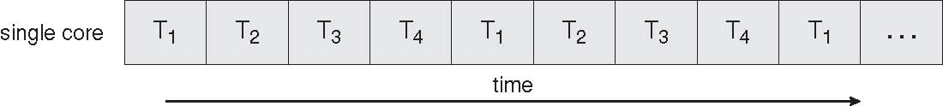
Concurrent Execution on a Single-core System
Concurrency means that execution of threads will be interleaved over time.

Slide 15
Multi-core Programming
Multicore: Multiple computing cores on a single chip.
Each core appears as a separate processor to OS.
Threads can run in parallel, separate thread on separate core.
Designers of OS must write scheduling algorithms that use multiple processing cores to allow parallel execution
Application programmers to write multi-threaded codes to take advantage of muticore systems

Slide 16
Multi-core Programming
Challenges include:
Dividing activities:
find areas that can be divided into separate concurrent tasks.
Balance:
Divided tasks must perform equal work of equal value
Data splitting
Not only application be divided, but data may also be splited among the threads.
Data dependency
IF data of one task depends on other’s, programmers must synchronize the execution of task.
Testing and debugging
More complex than testing and debugging single-threaded applications.

Slide 17
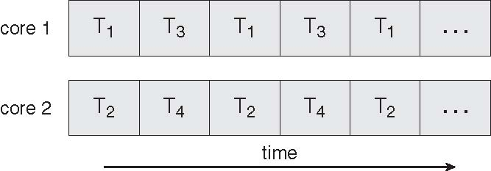
Parallel Execution on a Multi-core System

